Slide 1
Digital Portfolio
STUDENT NAME: Madhanbalaji.M
REGISTER NO AND NMID:
DEPARTMENT:
COLLEGE: COLLEGE : Chikkanna government arts college
UNIVERSITY: bharathiar University

Slide 2
PROJECT TITLE digital portfolio

Slide 3


AGENDA
Problem Statement
Project Overview
End Users
Tools and Technologies
Portfolio design and Layout
Features and Functionality
Results and Screenshots
Conclusion
Github Link
3/21/2024 Annual Review

Slide 4

PROBLEM STATEMENT
Students struggle to showcase their skills to recruiters. Lack of professional visibility without an online portfolio. Difficulty in organizing and presenting projects clearly.

Slide 5

PROJECT OVERVIEW
Purpose: To showcase skills, projects, education, and contact details. Mention: Responsive, user-friendly, and professional look. Add a small image/illustration of a portfolio mockup and colours and animation.

Slide 6

WHO ARE THE END USERS?
Target users: Recruiters/Employers Peers & collaborators Academic mentors
Students

Slide 7

TOOLS AND TECHNIQUES
List of tools: Frontend: HTML, CSS, JavaScript Backend : Not used Version Control: GitHub IDE: VS Code

Slide 8
POTFOLIO DESIGN AND LAYOUT
Home
About me
Resume
Skill
Project
Contact
8

Slide 9
FEATURES AND FUNCTIONALITY
Key features: Responsive design (mobile + desktop) Skills progress bars Contact form Social links integration Add icons (mobile, form, links).

Slide 10
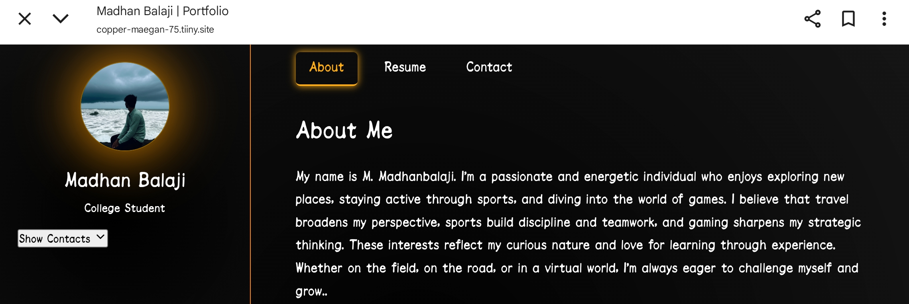

RESULTS AND SCREENSHOTS
3/21/2024 Annual Review
10

Slide 11
CONCLUSION
Summarize: Successfully built a personal portfolio website. Easy for recruiters to evaluate your skills. Scalable to add more projects in the future.
11

Slide 12
GitHub link
https://github.com/balajimadhan817-afk/Madhan-TNSDC-FWD-DP-.git

